Slide 1
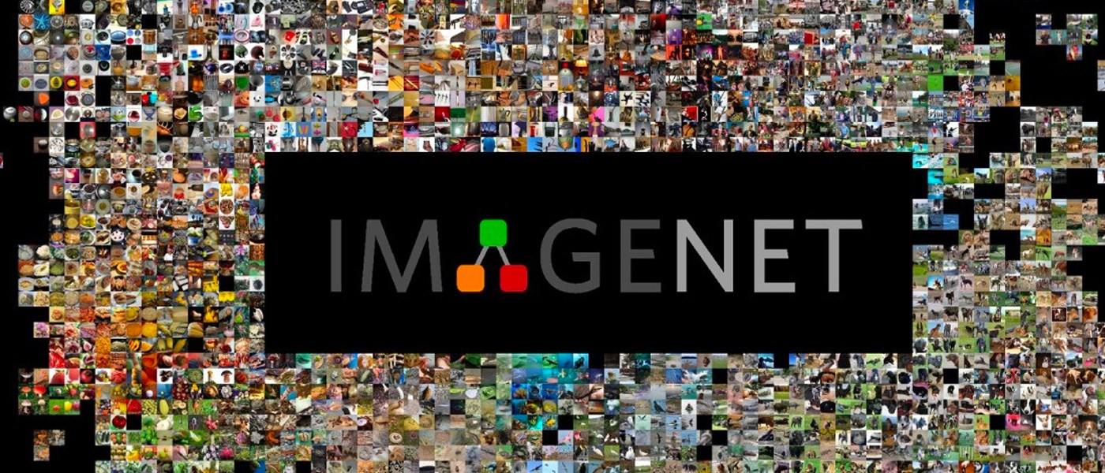



Object-detection and Caption Generation
“Machine Learning is all about learning from the past, applying in the present and predicting the future”

Slide 2
Team Members
Amandeep Kaur
Drishti Gupta
Ekant Bagri
Srinidhi Ayyagari

Slide 3
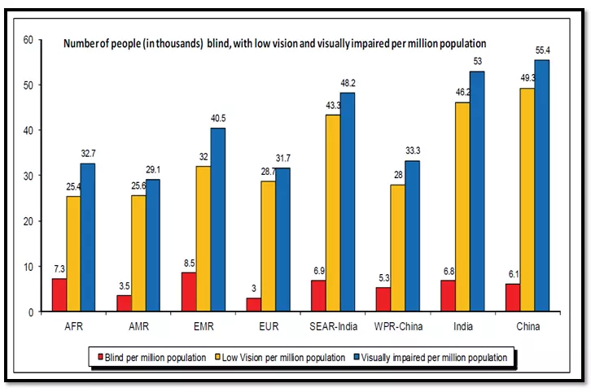
Inspiration and Project
Web is full of image-content.
We were inspired by the efforts of Andrej Karpathy, Fei fei li
We took the paper Show and Tell, and the dataset Imagenet for our reference.
The biggest obstacle we faced was that of data collection, though in the end it turned out to be the easiest. We settled on Flickr8k, and decided to compare our models and try to tune them so that we could improve their accuracy.
We hope to implement what we have learnt in future projects of computer vision.

Slide 4
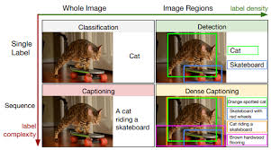
Abstract
Our aim is to perform image-to-sentence generation, also known as ‘Image Captioning’, which will bridge the gap between vision and natural language. If our results comes out to be accurate, we can then utilize NLP technologies to understand the world in images. The current dataset that we are working on is: Flickr8K. To achieve our goal, we are going to study and apply existing pre-trained CNN Models i.e. VGG16, ResNet50 & Inception V3. Further, we’ll be attaching our RNN using LSTM language model to it. In the end, We’ll be evaluating our results & comparing each one of them.

Slide 5
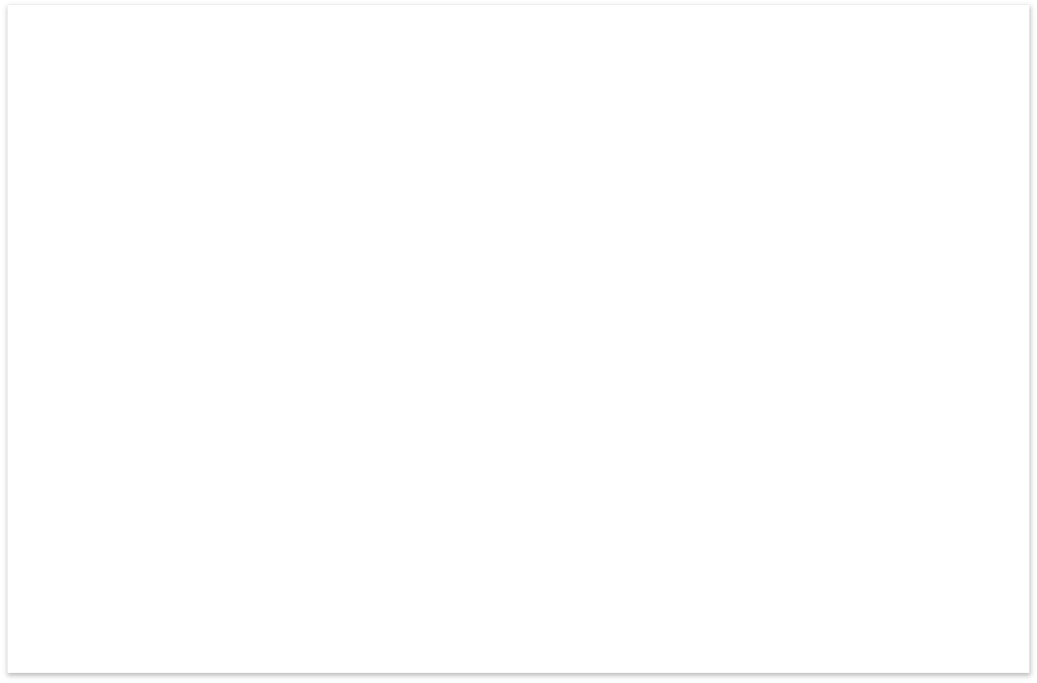
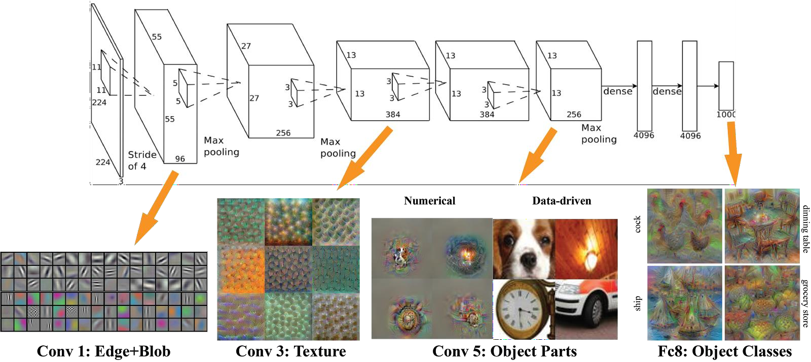
CNN as a Feature Extractor
Convolution layer is a feature detector that automagically learns to filter out not needed information from an input by using convolution kernel.
Pooling layers compute the max or average value of a particular feature over a region of the input data (downsizing of input images). Also helps to detect objects in some unusual places and reduces memory size.

Slide 6
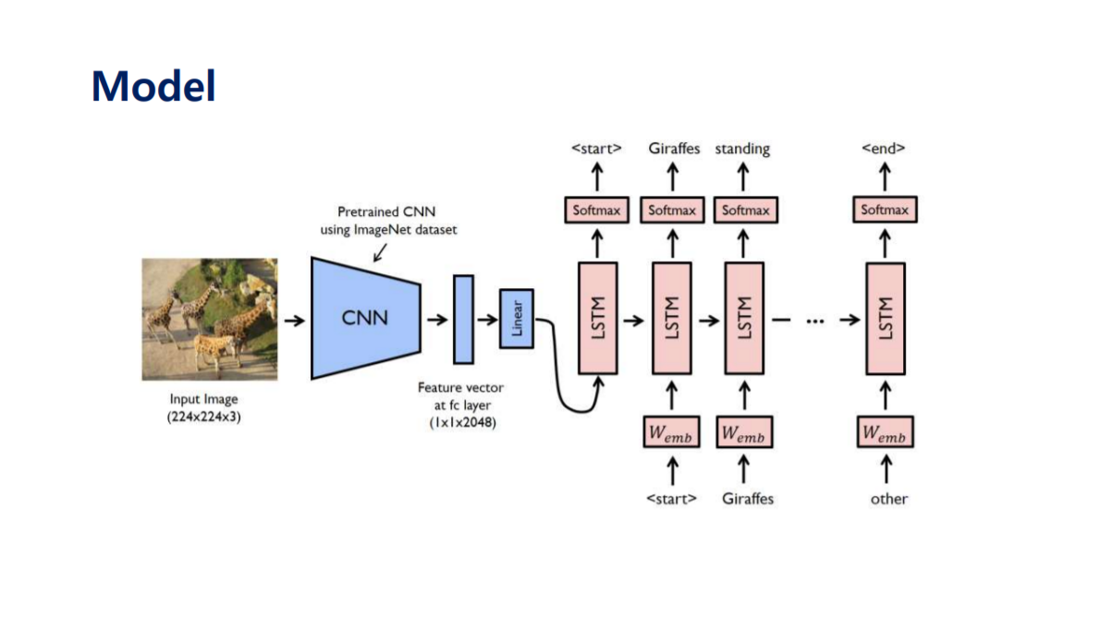
General Model Architecture

Slide 7
About the Dataset : Flickr8k
We have chosen Flickr8k dataset, the size of which we could later increase.
Flickr8k_Dataset: Contains a total of 8092 images in JPEG format with different shapes and sizes. Of which 6000 are used for training, 1000 for test and 1000 for development.
Flickr8k_text : Contains text files describing train_set ,test_set. Flickr8k.token.txt contains 5 captions for each image i.e. total 40460 captions.

Slide 8
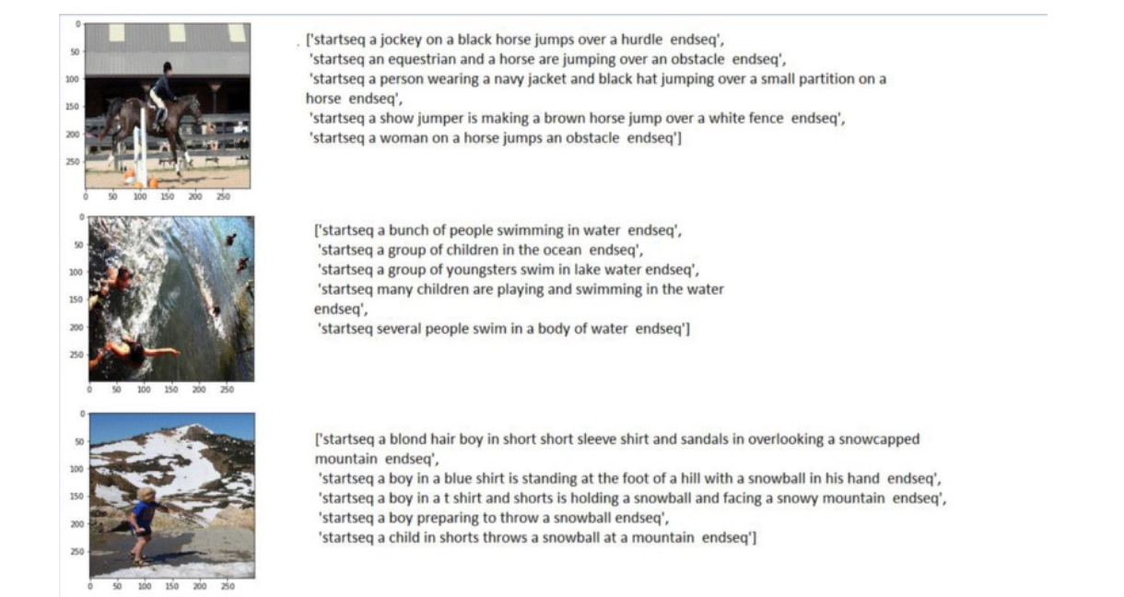
Expert Annotated Images In Flickr8k

Slide 9
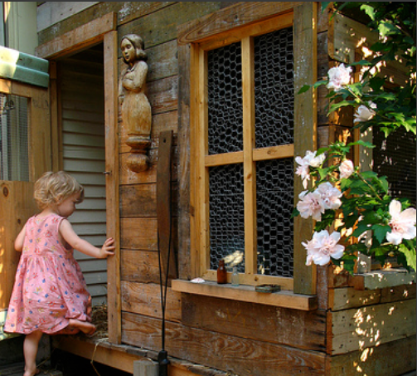
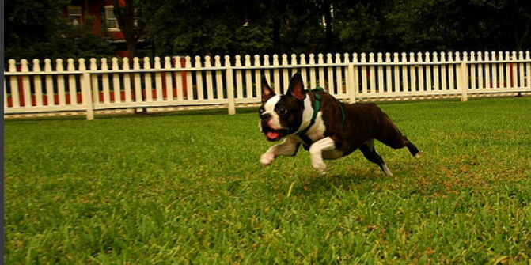
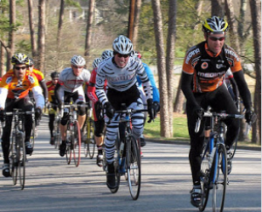
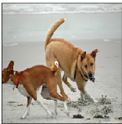
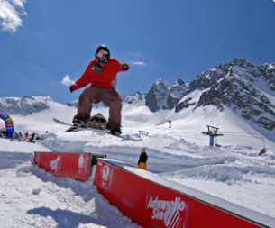
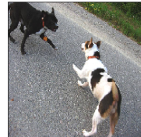
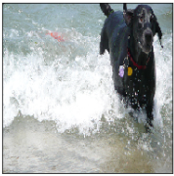
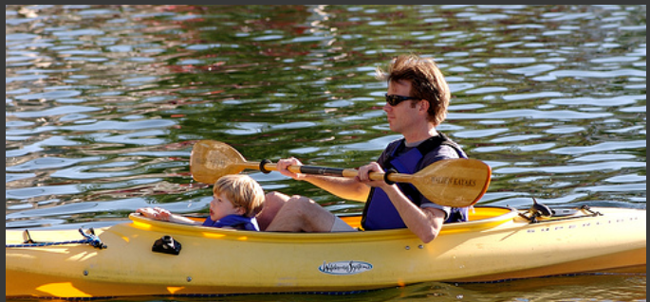
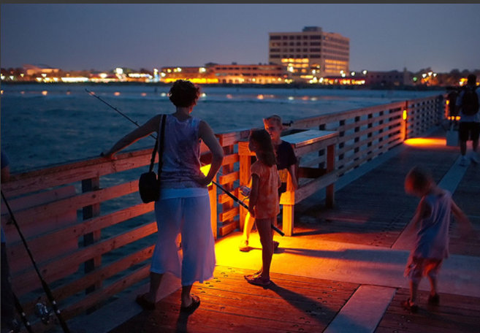
Flickr8k Dataset images

Slide 10
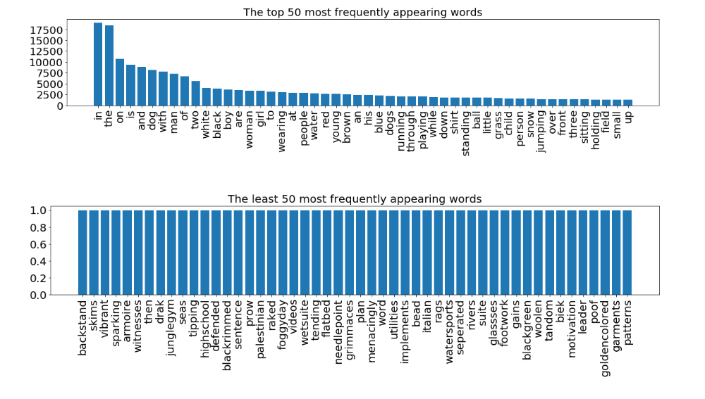
EDA

Slide 11
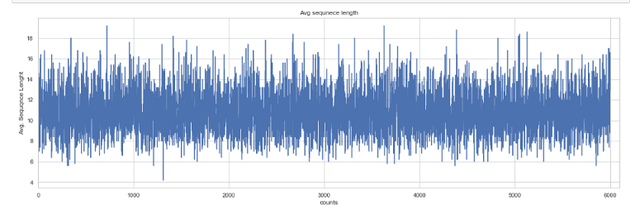
Plotting Caption Length
count 6000.000000
mean 10.815467
std 2.057137
min 4.200000
25% 9.400000
50% 10.600000
75% 12.200000
max 19.200000

Slide 12
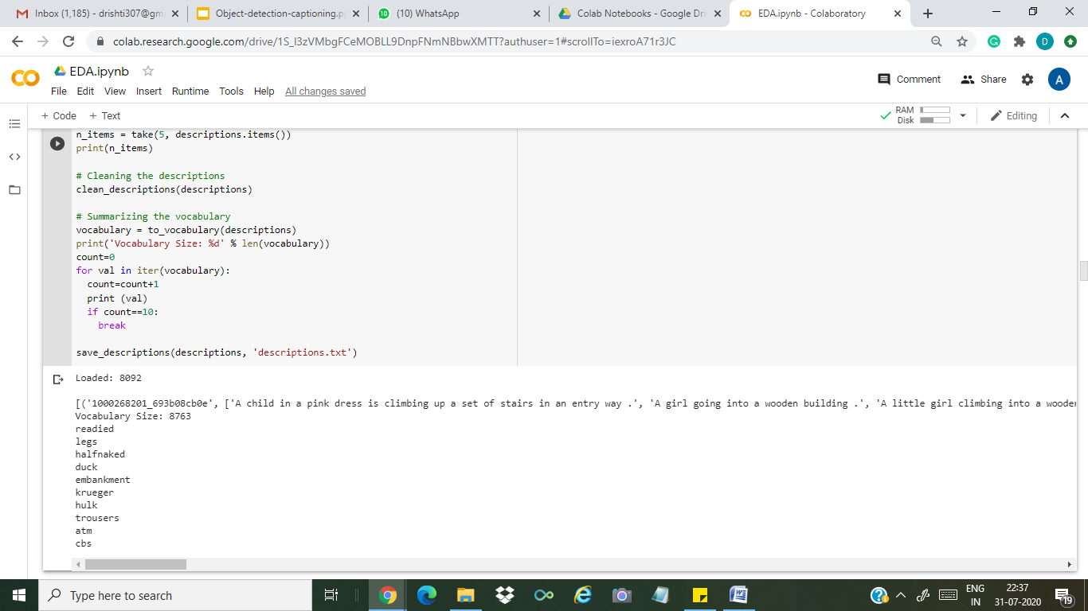
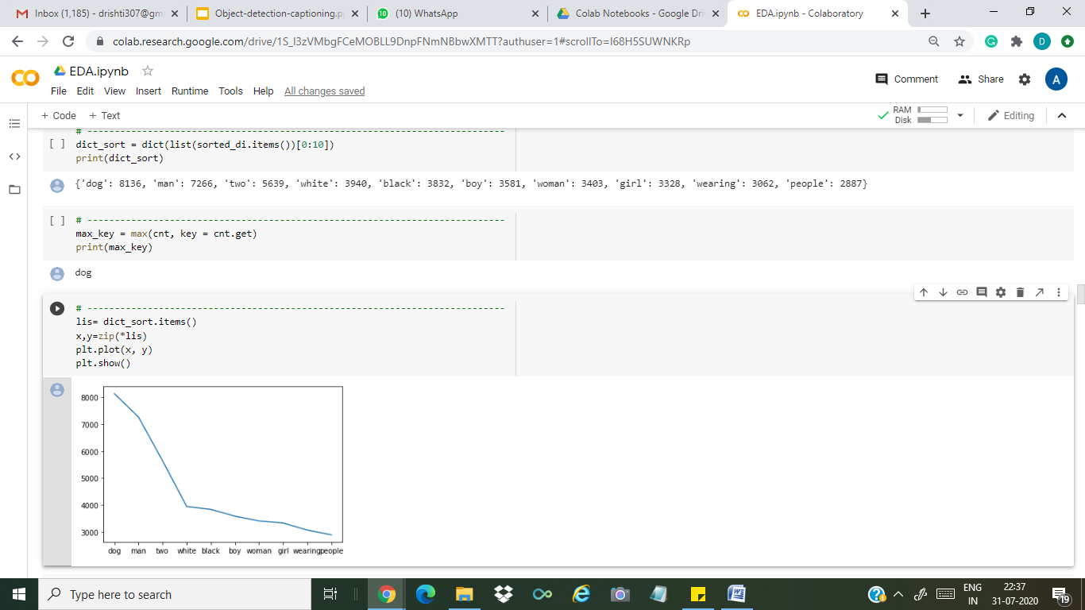
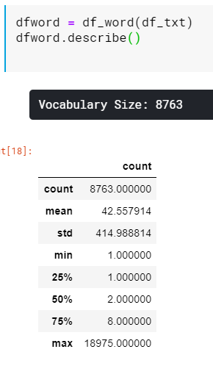

Slide 13
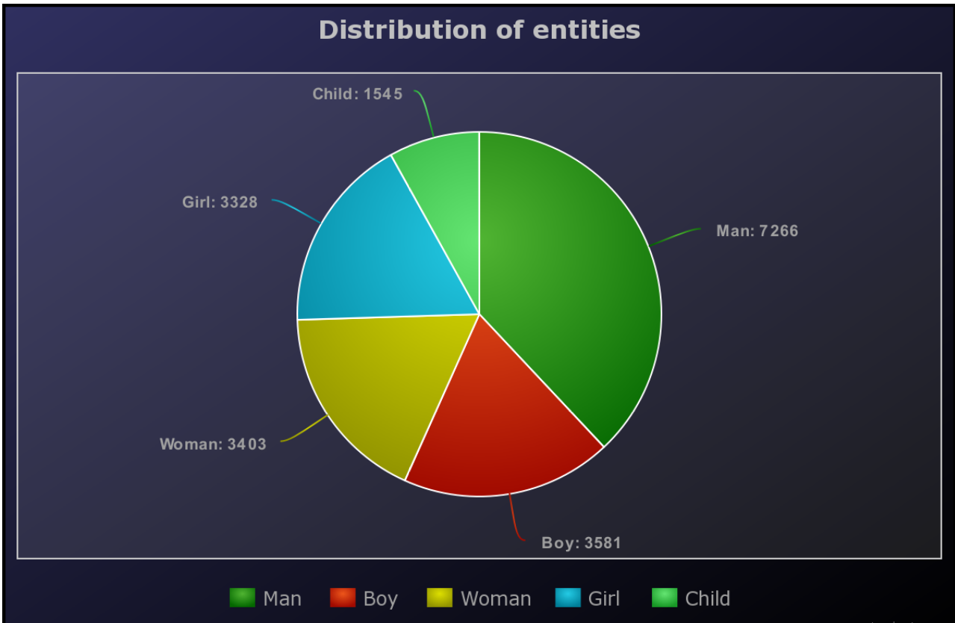

Slide 14
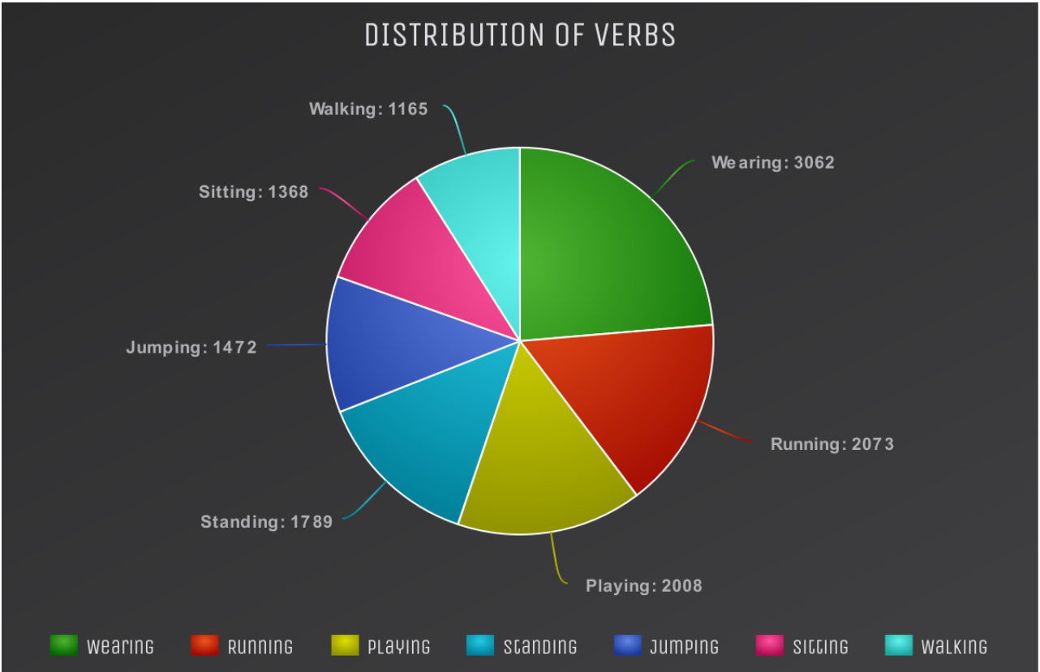

Slide 15
Data Preprocessing
( Common to all models )
The caption data was divided into 3 columns within the file as : “ Filename” , “Index”, “Caption”
Splitting done : for lines '\n' -> \t space given in columns #-> split as filename index caption,
Example : 1001773457_577c3a7d70.jpg#0 A black dog and a spotted dog are fighting
We create a dictionary with word as key and their frequency as value.
Next we removed Redundant data like single characters, punctuations and numeric values. Our Vocab size reduced by almost 155 words.

Slide 16
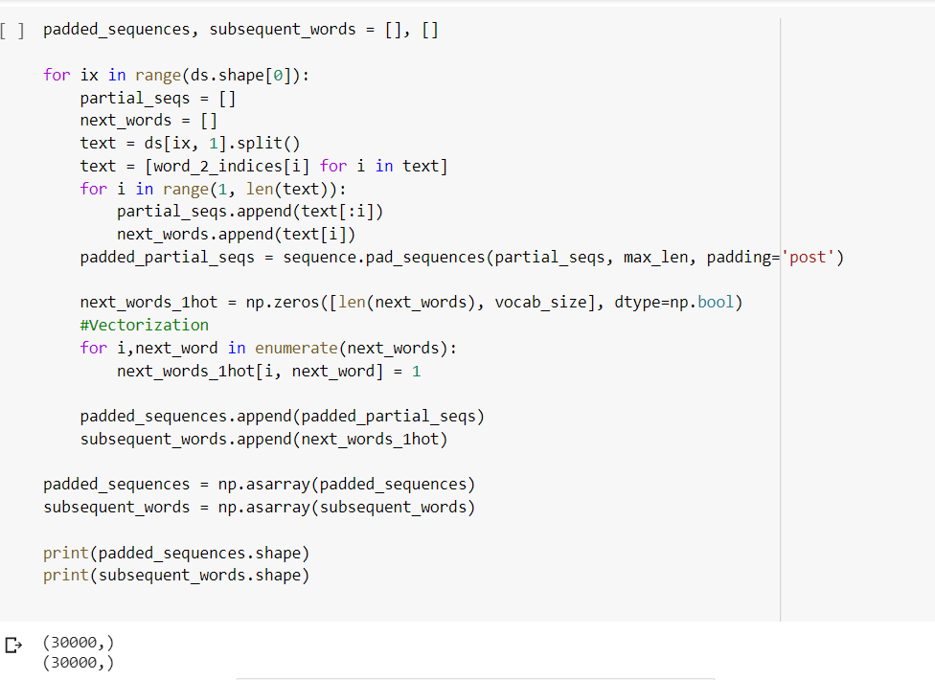
Caption Preprocessing

Slide 17
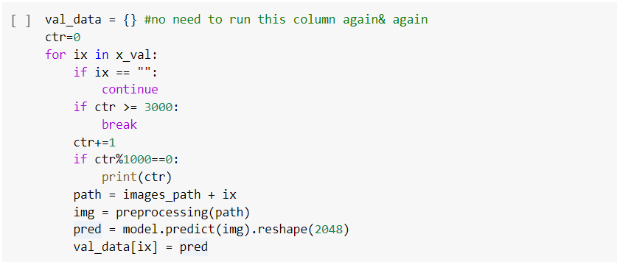
Image Preprocessing

Slide 18

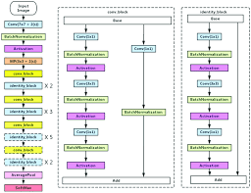
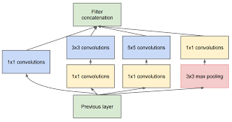
The Approaches considered
ImageNet has over ten million URLs of labeled images. About a million of the images also have bounding boxes specifying a more precise location for the labeled objects.
For this model, the ImageNet dataset is composed of 1,331,167 images which are split into training and evaluation datasets containing 1,281,167 and 50,000 images, respectively.
VGG 16 ResNet50 Inception V3

Slide 19
Model Summary :
VGG 16

Slide 20
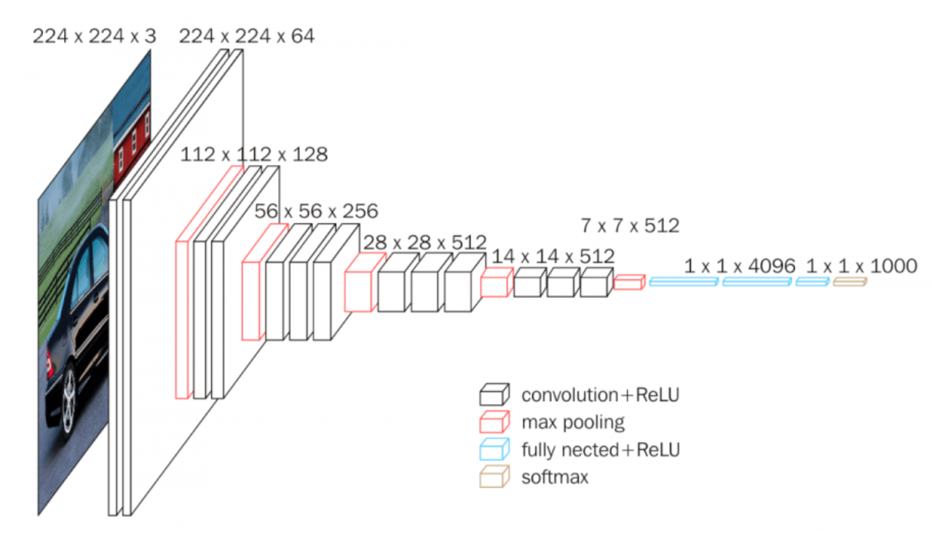
VGG 16
VGG 16 is a convolutional neural network model proposed by K. Simonyan and A. Zisserman from the University of Oxford in the paper “Very Deep Convolutional Networks for Large-Scale Image Recognition”. The model achieves 92.7% top-5 test accuracy in ImageNet, which is a dataset of over 14 million images belonging to 1000 classes.
Reference : https://neurohive.io/en/popular-networks/vgg16/

Slide 21
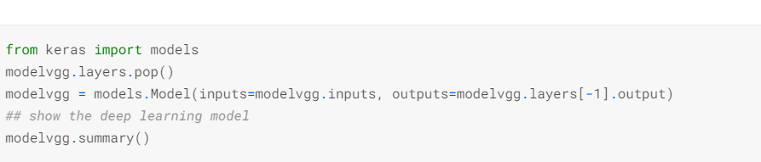
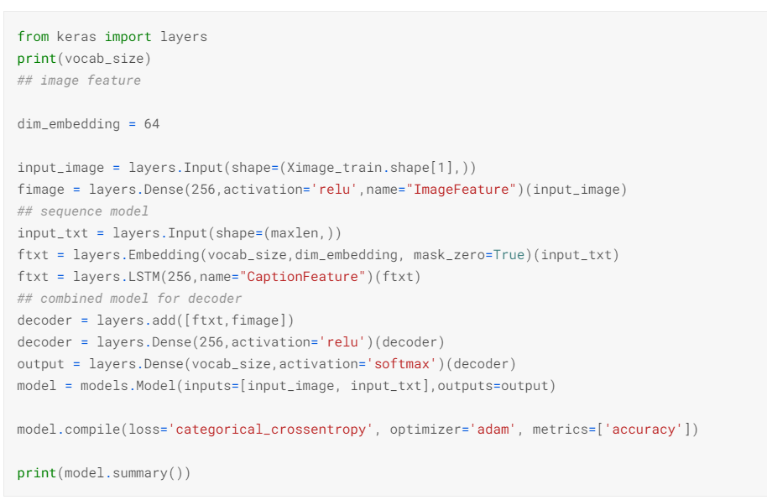
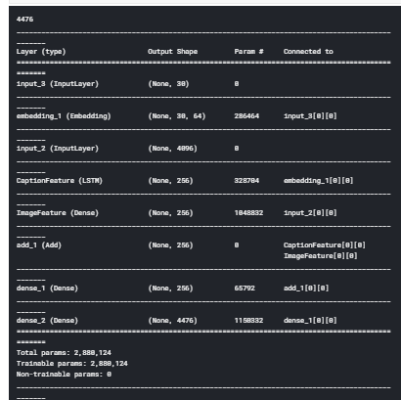
Glimpse of codes
The Source Code is available here :
https://www.kaggle.com/amandeepkaur2/image-captioning-using-vgg16-on-flicker8k-dataset?scriptVersionId=39769355

Slide 22
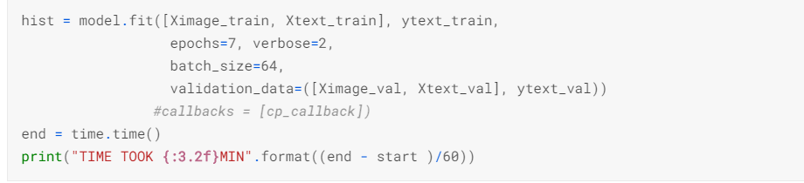
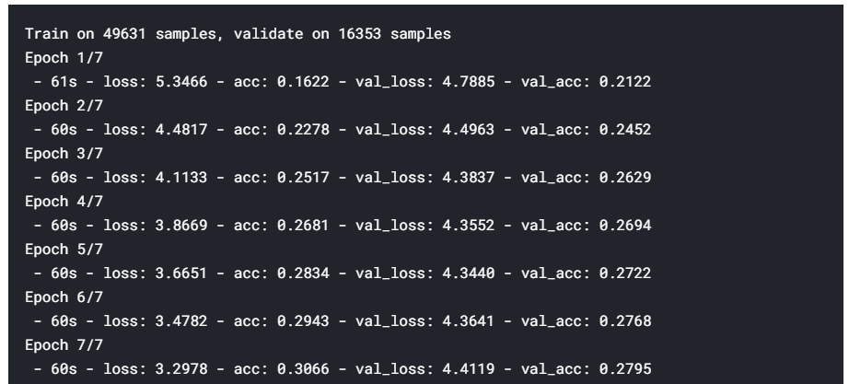
Accuracy and Loss per epoch

Slide 23
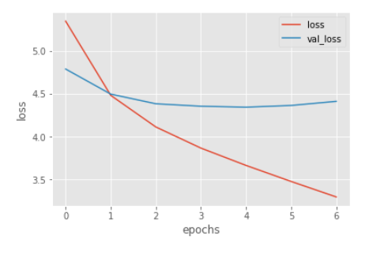
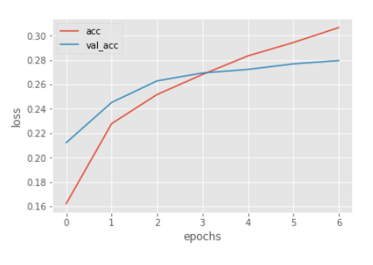
Evaluation and Results
Plot between Training Loss and Validation Loss
Plot between Training Accuracy and Validation Accuracy
Accuracy

Slide 24
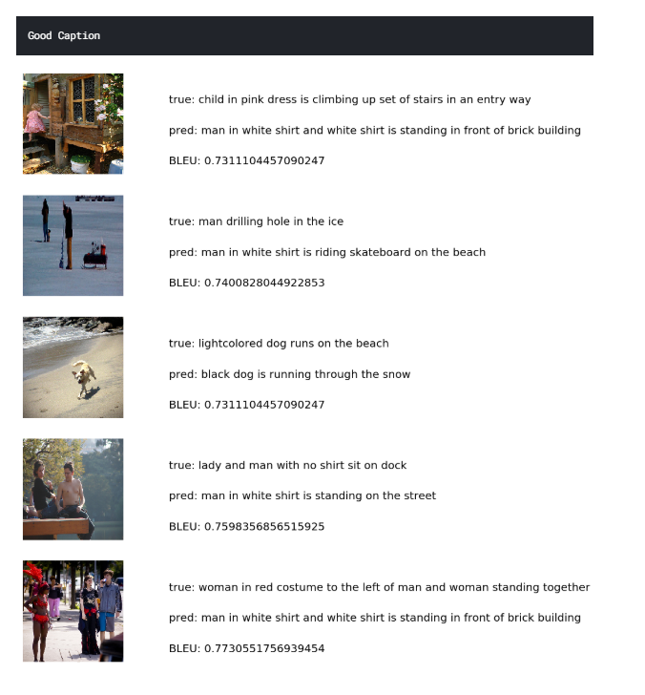

Slide 25
Model Summary :
ResNet 50

Slide 26
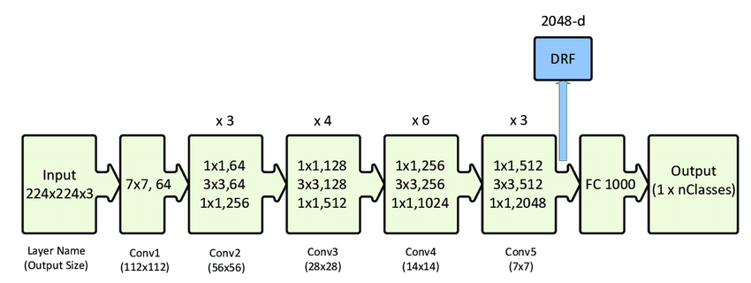
ResNet 50
(Transfer Learning)
ResNet 50
ResNet-50 is a convolutional neural network that is 50 layers deep. You can load a pre-trained version of the network trained on more than a million images from the ImageNet database . The pretrained network can classify images into 1000 object categories, such as keyboard, mouse, pencil, and many animals

Slide 27
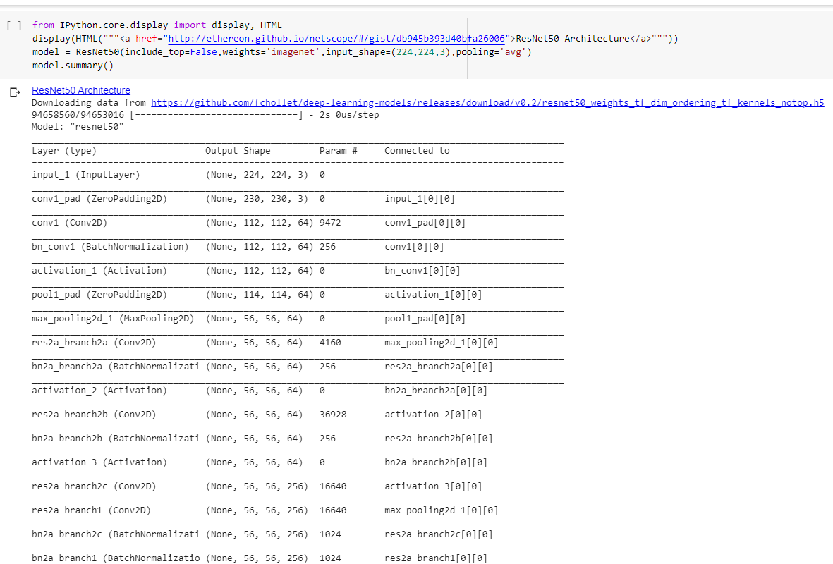
Glimpses of Code

Slide 28
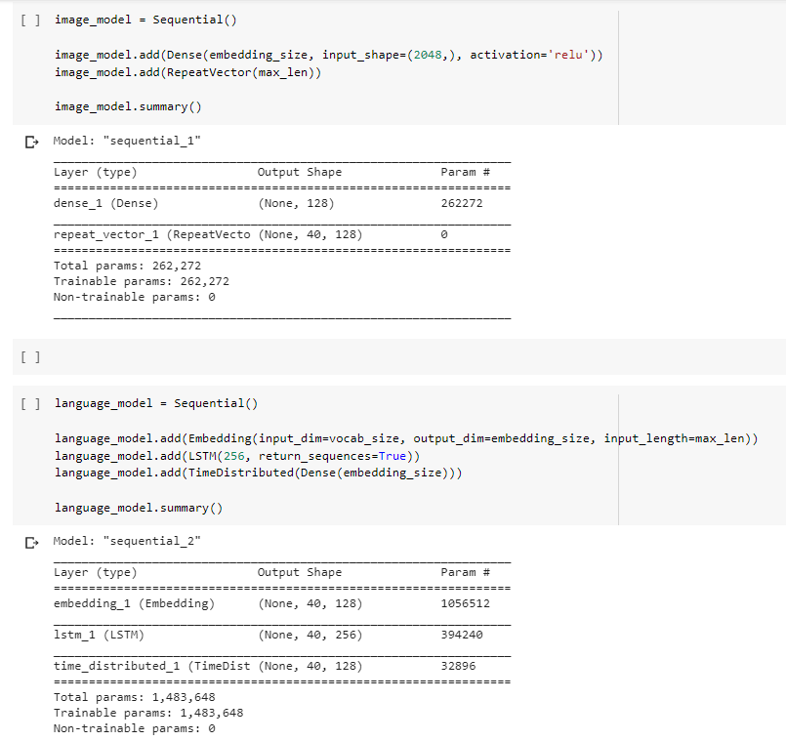
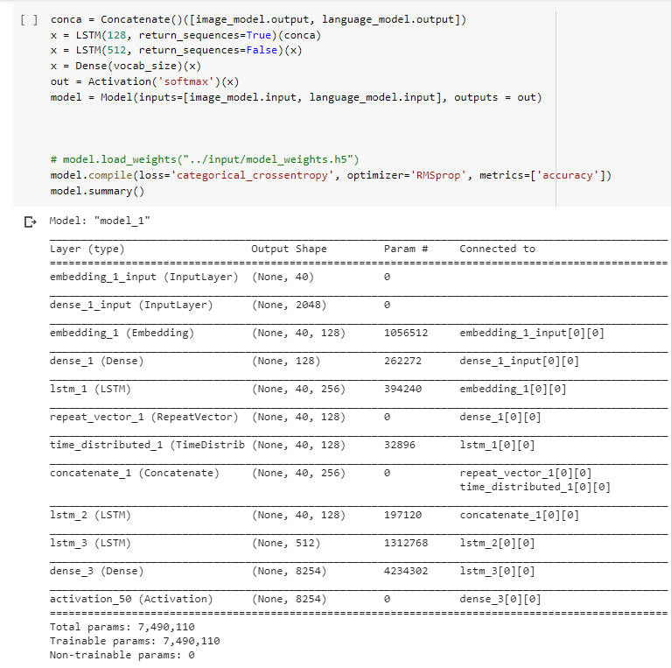
Adding last layer as language Model

Slide 29
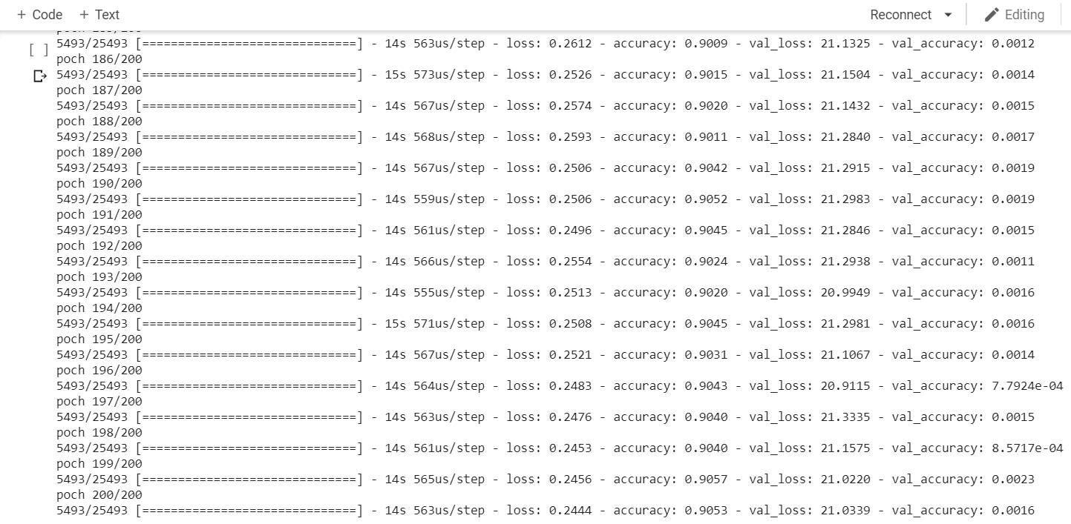
Accuracy & Loss per epoch
Net Accuracy on Training Data: 90.53%

Slide 30
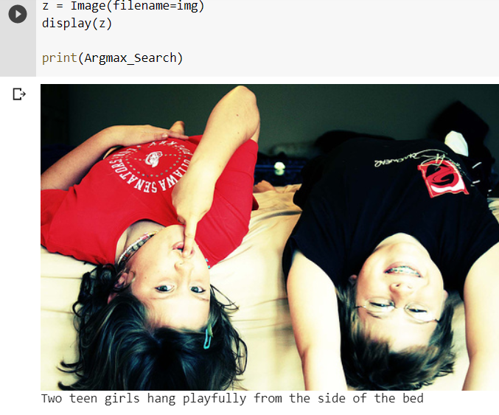
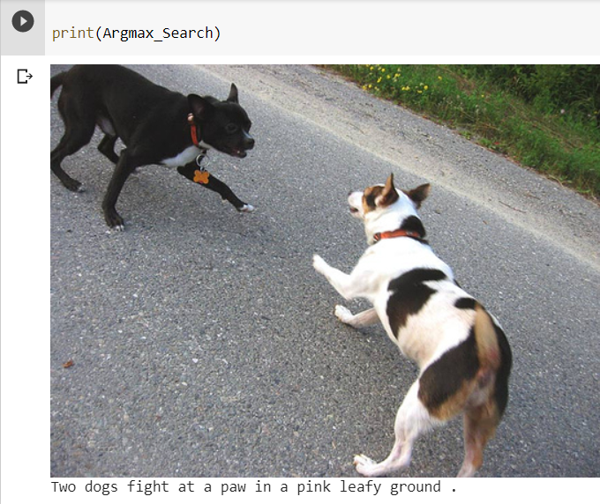
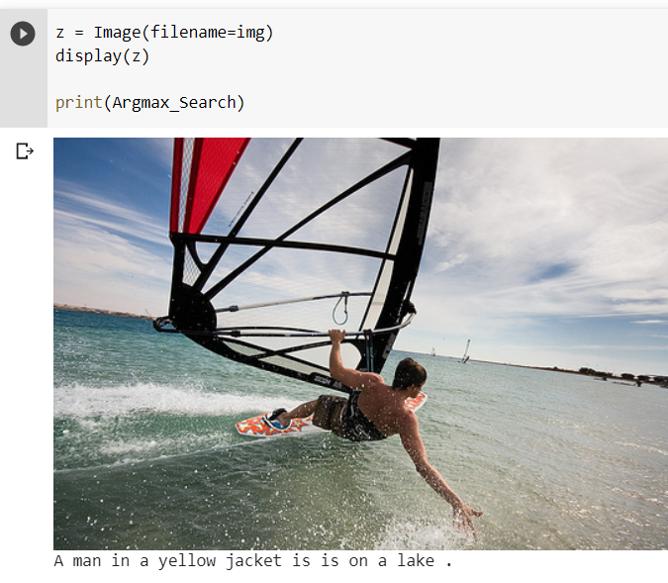
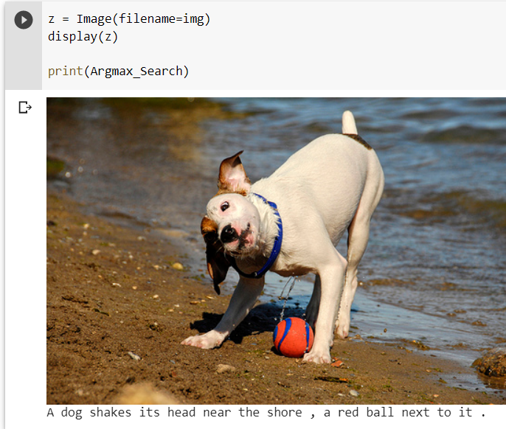
Predicted Captions

Slide 31
Model Summary :
InceptionV3

Slide 32
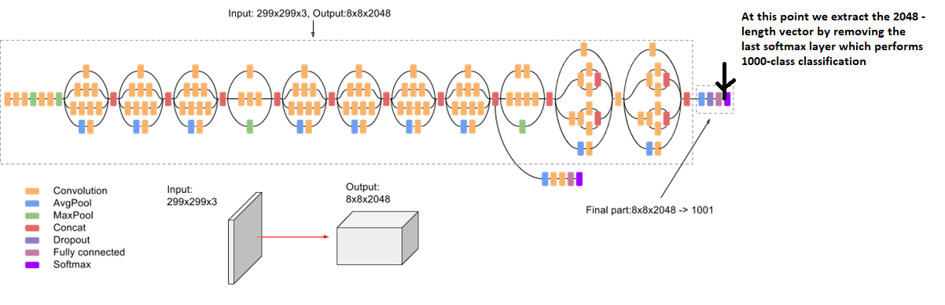
Inception V3 is a Deep Learning Convolutional Architectures.
Inception V3 was trained using a dataset of 1,000 classes from the original ImageNet.
It is 48 layers deep. It is pre-trained on the ImageNet dataset
List of classes of images is: https://gist.github.com/yrevar/942d3a0ac09ec9e5eb3a

Slide 33
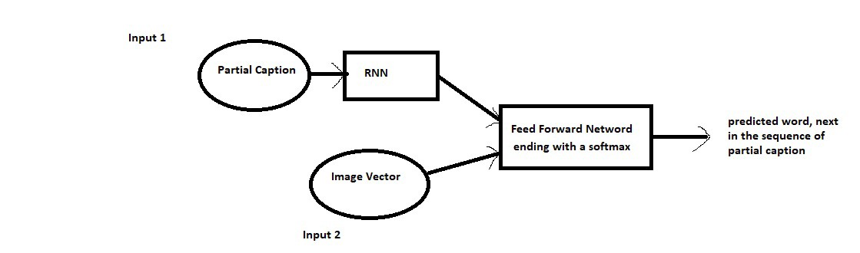
The Approach
Images are input and for any model the input must be a vector.
This is where the InceptionV3 comes in.
The last layer/ softmax layer performs the 1000 class classification. But we don't want to classify the image. We want a fixed-length informative vector for each image.

Slide 34
The Approach
For every caption to be generated, we provide image vector and the first two words as input and try to predict the third word
it’s not just the image which goes as input to the system, but also, a partial caption which helps to predict the next word in the sequence.
Since we are processing sequences, we will employ a Recurrent Neural Network to read these partial captions

Slide 35
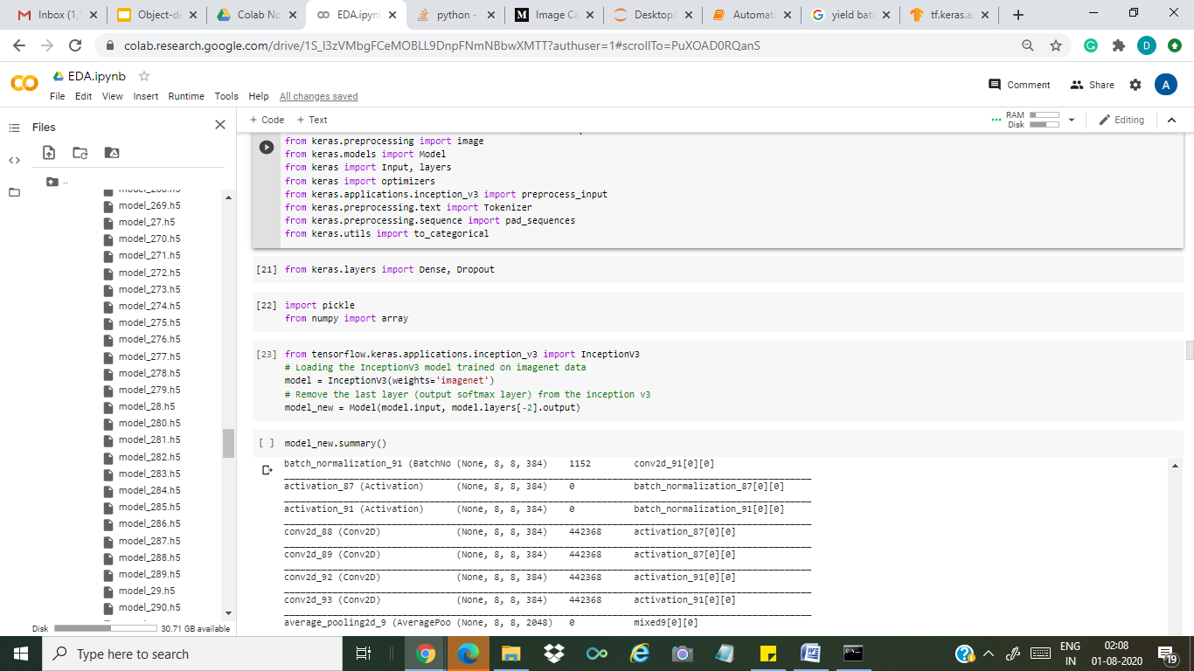
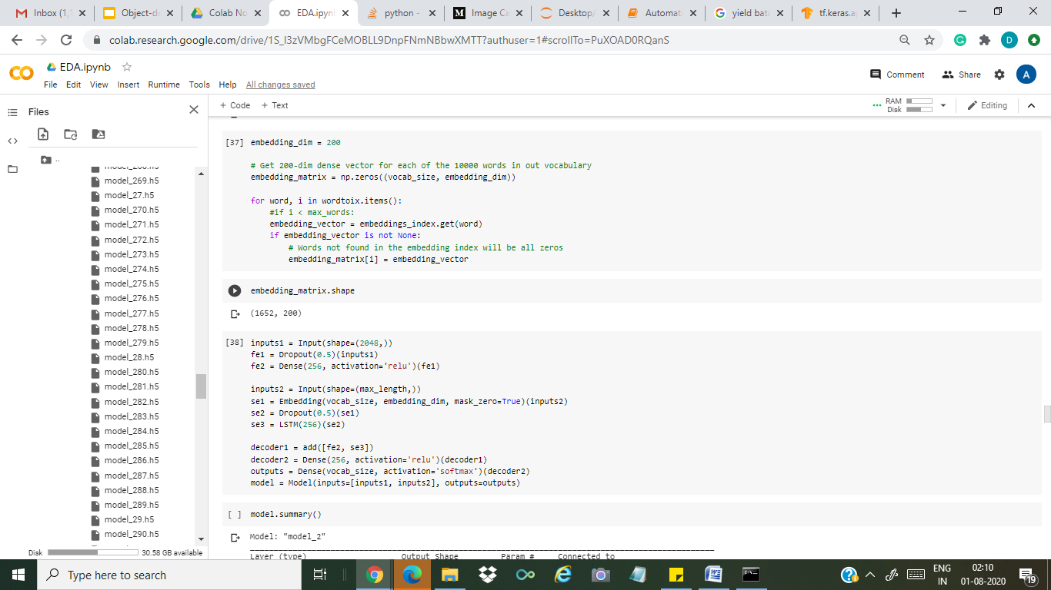
Glimpse of codes
The Source Code is available here :
https://drive.google.com/file/d/1S_l3zVMbgFCeMOBLL9DnpFNmNBbwXMTT/view?usp=sharing

Slide 36
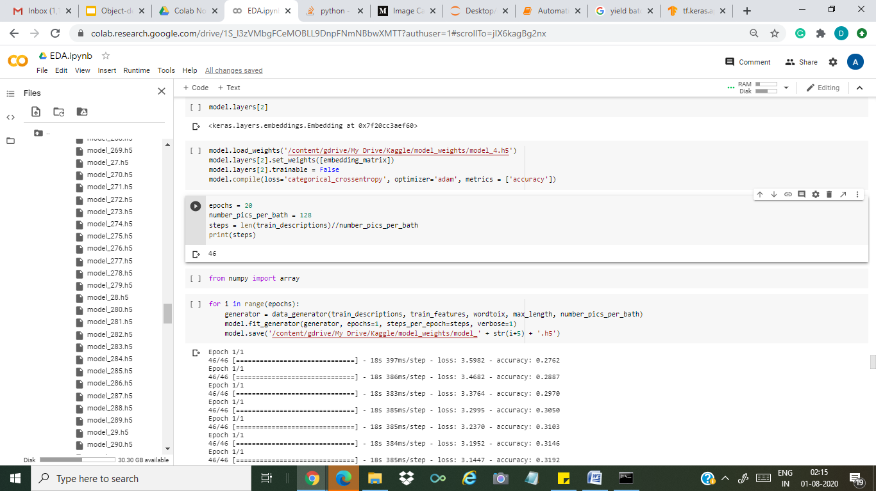

Accuracy and Loss per epoch

Slide 37

Using GREEDY Approach to Generate Captions
Greedily selecting the word with the maximum probability, is also called as Maximum Likelihood Estimation (MLE).

Slide 38



Slide 39






Slide 40
Conclusion
Once we re-trained our respective models on our dataset, we came out with the following conclusion.
Inception V3 (Accuracy: 51%)
ResNet 50 (Accuracy 90%)
VGG 16 (Accuracy 31%)
We tested our models by generating captions on test data, compared them to the expert annotated texts, and concluded that even though ResNet 50 showed the highest Accuracy, the results were not that satisfying ergo the model was overfitting. VGG 16 also gave decent results but was more time consuming in comparison to others.So, Inception V3 giving better results and tops the list.

Slide 41
Future Scope
Analysis of the models using various other accuracy metrics
Increasing our dataset size
Adding more categories.
Include Grammar check in our generated captions.

Slide 42


Applications
By adding Text to Speech feature, our model can be scalable for use by Visually impaired people
In education industry, our model can be extremely useful for teaching young children
We propose to build a website using Flask through which users can upload images and generate captions. Text to Speech feature can be considered as an extension of this application.

Slide 43



Bibliography
VGG 16
https://fairyonice.github.io/Develop_an_image_captioning_deep_learning_model_using_Flickr_8K_data.html
ResNet50
https://www.kaggle.com/shadabhussain/automated-image-captioning-flickr8
Inception V3
://medium.com/@raman.shinde15/image-captioning-with-flickr8k-dataset-bleu-4bcba0b52926
Inception V3
https://towardsdatascience.com/image-captioning-with-keras-teaching-computers-to-describe-pictures-c88a46a311b8
Excels in tasks where the basic unit (pixel, word) has very little meaning in itself, but the combination of such units has a useful meaning.

Slide 44

We express our gratitude to all the mentors for providing us with this opportunity to expand our learning horizons.
Thanks & Regards
Notes:
https://www.pyimagesearch.com/2017/03/20/imagenet-vggnet-resnet-inception-xception-keras/

Slide 45
Submitted by:
Ekant Bagri | 1803147.cse.cec@cgc.edu.in | BTech(CSE)
Atul gujjar | 1803136.cse.cec@cgc.edu.in | Btech(CSE)

